Slide 1
Coffee Shop Analysis
Data Insights and Business Decision-Making

Slide 2
Audience:
Business Owners and Managers
Marketing and Sales Teams
Objective:
Evaluate the most effective marketing strategies for current market in order to achieving max-profit.
Understand how location, month, and day of the week influence customer behaviour and customer preference in ordering beverages and foods.

Slide 3
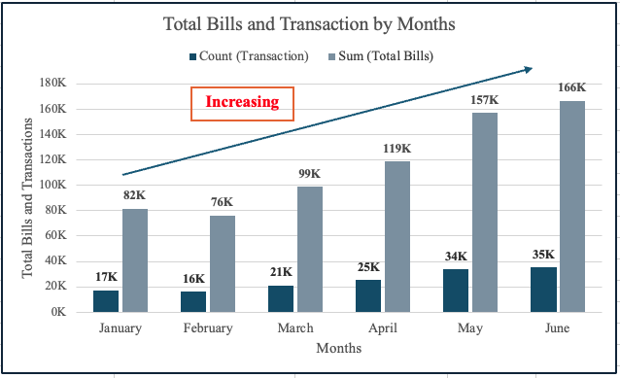
Number of Transactions and Total Bill for each months? Is there any pattern that transactions and total bills have if any?
Insight:
Number of purchases increasing each month.
Assumption:
Since the sales is increasing by a larger margin every two months, there might be a seasonal factors at playing behind.

Slide 4
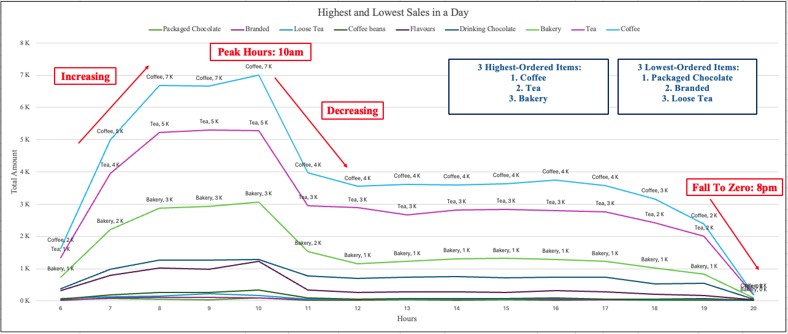
Which products selling the highest and the lowest in a day?
Insights:
Top Sales Items: Coffee (Highest), Tea and Bakery
Low Sales Items: Packaged Chocolate, Branded and Loose Tea
Peak Sales Period: 6AM to 10AM

Slide 5
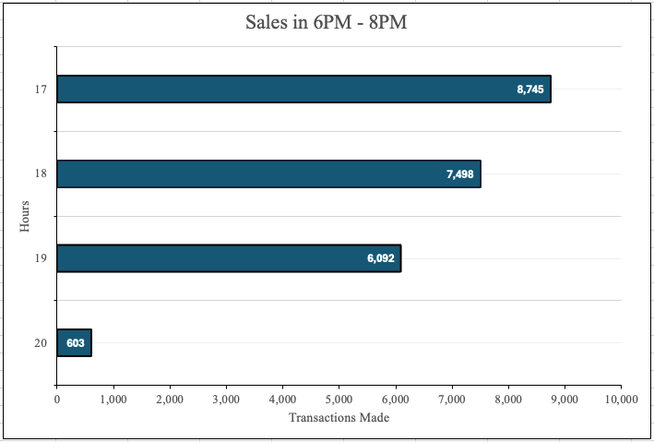
Sales from 6PM to 8PM
Insights:
Sales drops significantly from 8,745 at 5PM to just 603 by 8PM.
The sharp drop-off between 7PM to 8PM could be due to a decrease in customer traffic and others.

Slide 6
Promotions:
Offer promotions or bundle deals involving high-selling items with low-selling items to boost the sales.
For Example, “Buy 1 Coffee, Get a Discount on a Loose Tea”
Targeted marketing campaigns for low-selling price.
Peak Sales Period:
Introduce morning specials or discounts from 6AM to 10AM.
For Example, “Morning Happy Hour: 10% off on all drinks.”
Increase staff to handle the increased customer volume efficiently.
Afternoon Sales Period:
Offer promotions in the afternoon and evening to encourage more sales during these dropping periods.
Host events and activities to draw customer in.
For Example, Events such as book readings, workshops and live music.
Operating Hours:
Closing earlier until 6PM to focus on maximizing sales during the morning and afternoon.
For example, Use the savings from reduced late-hour operations to increase budget for the morning and afternoon period.

Slide 7
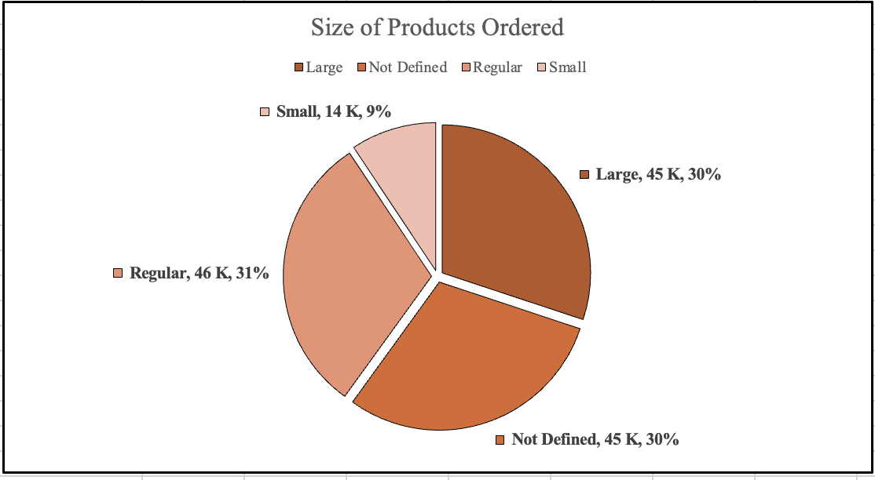
What size of each product have been selling more and less?
Product Size Data:
Large, Regular and Undefined Sizes have almost in same number o purchases, but the Regular has little more than the other two.
The small size order is the lowest in number of sales and customers are not interested in small sized orders.

Slide 8
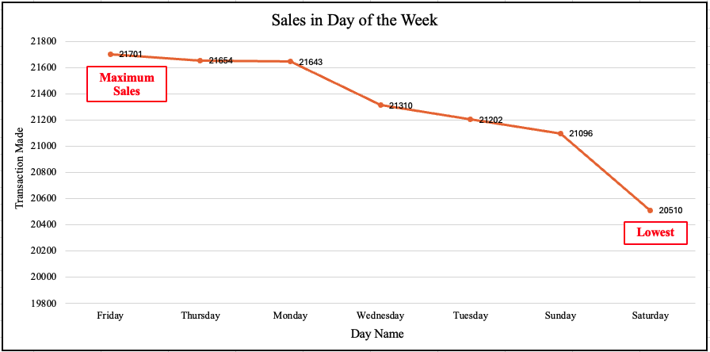
Which day has more sales and less?
Weekly Sales Data:
Friday experiences the highest number of purchases during the week.
Saturday is the lowest number of purchases in the week.

Slide 9
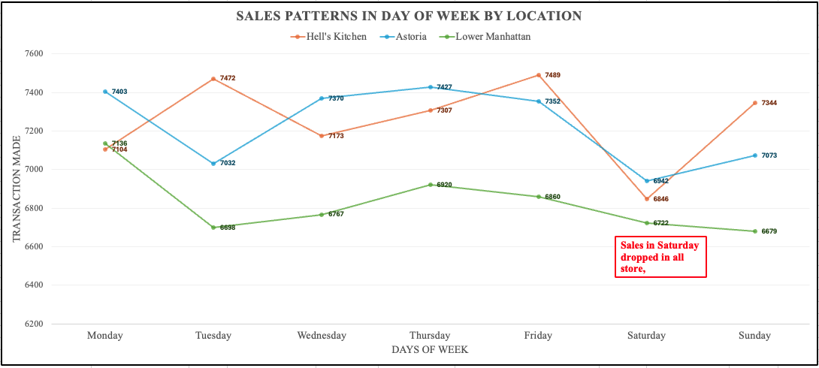
Weekly Sales Data by Location
Geospatial Analysis:
Highest for Astoria on Thursday and all locations experience the lowest number on Saturday.

Slide 10
Recommendations
Size:
Focusing on the benefits and value of the regular and large sizes.
Collecting feedback from customers who dislike using small sizes and implementing distinctive strategies for small-size orders.
If small size orders still do not generate a profit after adjustments, consider eliminating small-size alternatives.
Low Saturday Sales:
Customers' feedback on why they are less active on Saturdays, and how to figure out the problem. (competition, promotions, and leisure activities)
Create extraordinary offers and events to attract customers' interest.
Using social media to promote Saturday events on all locations.

Slide 11
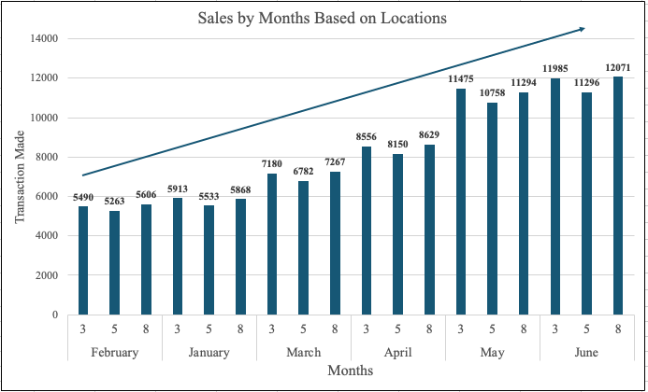
Customer purchase behavior by location and month
Seasonal Trends:
February to April: Gradually increase.
May and June: This two months are coming with the best sales figures in the period, showing a significant increase in customer purchases.

Slide 12
May and June (Summer Months)
Insight:
Warmer Weather makes people are more likely to get beverages and take vacation, leading to higher spending.
Summer months which also considered as school holidays and peak tourist season, resulting in higher sales in the year.
Summer months tends to offer more festivals, providing opportunities to increase brand visibility and attract new customers.
Recommendations:
Provide summer-specific promotions, discounts and sales events to attract customers.
Partnership with tourist attractions and hotels to offer special offers to tourist.

